Slide 1
CS 419: Production Rendering Specular Reflection
Eric Shaffer

Slide 2
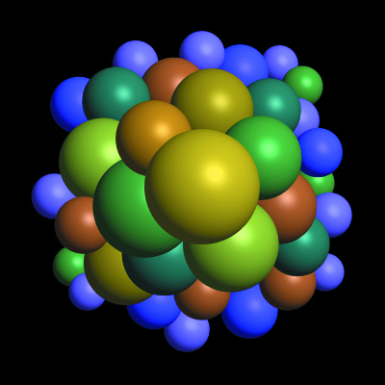
Objectives
Understand one way of modeling glossy specular
Know how specular reflection can be implemented
Seen how how a lighting model can be view-dependent

Slide 3
Modeling Specular Reflections
Glossy specular refection clusters reflection directions around the mirror reflection direction
Call this direction r…we must derive an expression for it…

Slide 4
Modeling Specular Reflections

Slide 5
Modeling Specular Reflection
How do we model clustering of radiance around r?
Decrease radiance as angle between r and ω_{o} increases

Slide 6
Modeling Specular Reflection
How do we model clustering of radiance around r?
Decrease radiance as angle between r and ω_{o} increases
Phong Specular Model

Slide 7
The Phong Model is Non-Physical
Lacks reciprocity and does not conserve energy…
Can modify reflected specular radiance to be:
Conserves energy if k_{d}+k_{s} <1.0

Slide 8
A Full Phong-style Reflection Model
For n point and directional lights
j is index for each light

Slide 9

Example of Increasing e

Slide 10
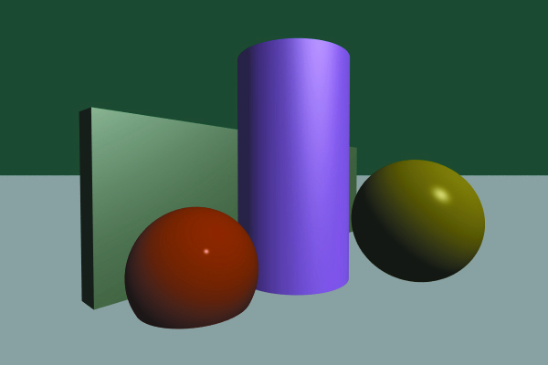
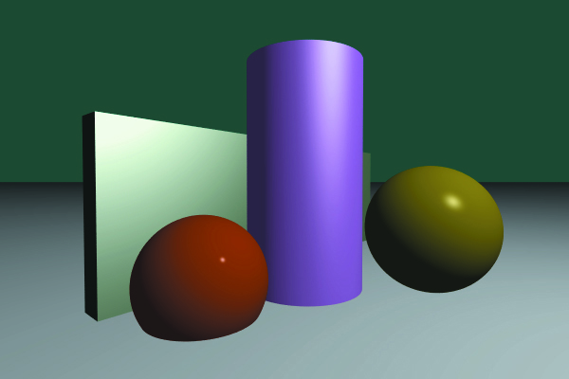
Example: Directional and Point Light

Slide 11
Viewer Dependence
Specular effects depend on position of the eyepoint
Fix the position of a surface plane and light
The apparent position of the highlight is different for positions a and b

Slide 12
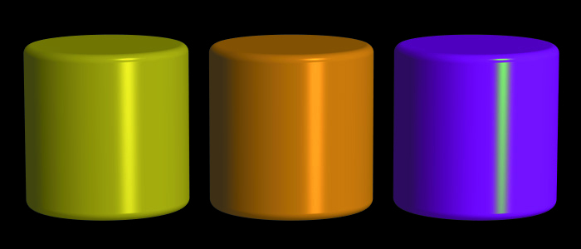
Colored Highlights
Suppose you want non-white highlights even when the light is white….
Introduce a specular color c_{s}

Slide 13
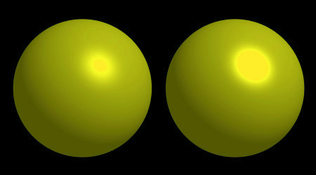
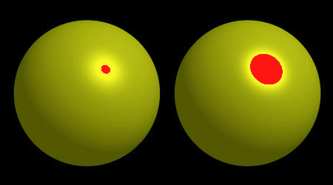
Overflow

Slide 14
Blinn Modification
Jim Blinn suggested using the halfway vector h instead of r
When would this be beneficial?

